Slide 1
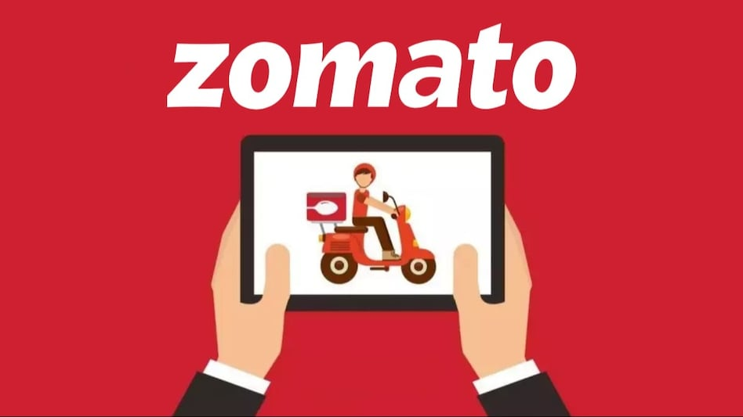
Presentation On ZOMATO ANALYSIS PROJECT
Group -3

Slide 2
Project members
Sayali M Thakre
Teppala Chand Begam
Pamarthi Rohitha
Someshwar Dinesh Gundlapalli
Rayala Sai Kumar

Slide 3
AGENDA
INTRODUCTION
DATA OVERVIEW
OBJECTIVES
KPIs
DESHBOARD
CONCLUSION

Slide 4
INTRODUCTION
Zomato is one of the world’s leading online food delivery platforms. The Zomato ,It allows users to explore restaurants ,view menu ,read and write reviews ,and make table booking .Zomato also offers online food services and orders from partnered restaurants .Founded in 2008,the operates in multiple counties and provides insights like ratings ,pricing, and location based on recommendations .Finally ,Zomato is one of popular businesses in world.

Slide 5
DATA OVERVIEW
The Zomato Restaurants Dataset contains information on various restaurants listed on Zomato across multiple cities worldwide.
The dataset provides key attributes that can help analyze the restaurant's popularity, customer preferences, and overall performance .
The Zomato report assesses key performance indicators [KPIs] to mange business difficulties. It uses interactive dashboards from excel ,power bi ,and tableau to analyze the data and clear visual into customer behavior ,and revenue performances .
SQL is used to data exact processing It resulting in accurate analysis. In this, we have challenges and provides decision making and growth.

Slide 6
OBJECTIVES
1.To identify the various strategies adopted by various restaurants. 2.To analyse how Zomato is different from its competitors. 3.To analyse the perfect location and perfect cuisines for restaurants to open at certain places. 4.To analyse which food is famous in which places. 5.To analyse relationships between restaurants, food and ratings.

Slide 7
KEY PERFORMANCES INDICATIORS[KPIs]
1.Data Model Here ,we will build a relational data base connecting all relevant tables from dataset. 2.Date table Here ,we will create date table from Date key opening with the year ,Month No, Month Full Name , Quarter ,year Month , weekday No ,weekday Name, Financial Month, Financial Quarter. 3.Restaurant count-Here ,we have number of restaurants in multiple cities ,countries. 4.Opening Date-Here ,we have restaurant openings by year ,month , quarter.

Slide 8
5.Bucket pricing Here ,we have group of restaurants into bucket pricing. 6.Average Ratings Here ,we have to count restaurants by average rating. 7.Percentages Here ,we have percentage of restaurants like online delivery or Table booking. 8.Currency Conversion-Here ,we need to convert Currency into USD. 9.Dashboard-Here ,we will make interactive dashboards with help of above KPIs and visuals.

Slide 9
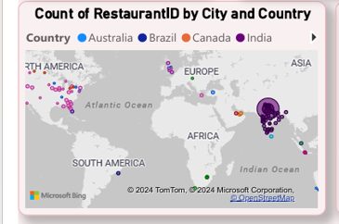
Count of RestaurantID by City and Country
Count of RestaurantID by city and country are mor in “India and Australia” among other.
In India the countryID is “1”,
In Australia the countryID is “14”.

Slide 10
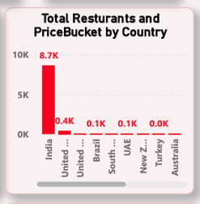
Total Resturants and priceBucket by country
Total resturants and priceBucket by country are more in “India” among other country.
The percentage of priceBucket in india is “8.7k”.
The priceBuckets are like 0-5000,5000-10000.

Slide 11
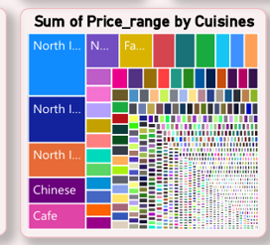
Sum of price range by cuisines
Sum of price range by cuisines are based on “sizes”.
In this we can take different charts.
The sizes is based on ascending order by different country.

Slide 12
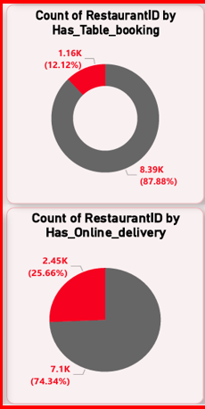
Percentage of Restaurants based on “Has Table booking” & “ Has Online delivery”
Has Table Booking:
Total % Restaurants has No Table Booking: 87.88 %
Total % Restaurants has Table Booking: 12.12 %
Has Online Delivery:
Total % Restaurants has No Online Delivery: 74.34 %
Total % Restaurants has Online Delivery: 25.66 %

Slide 13
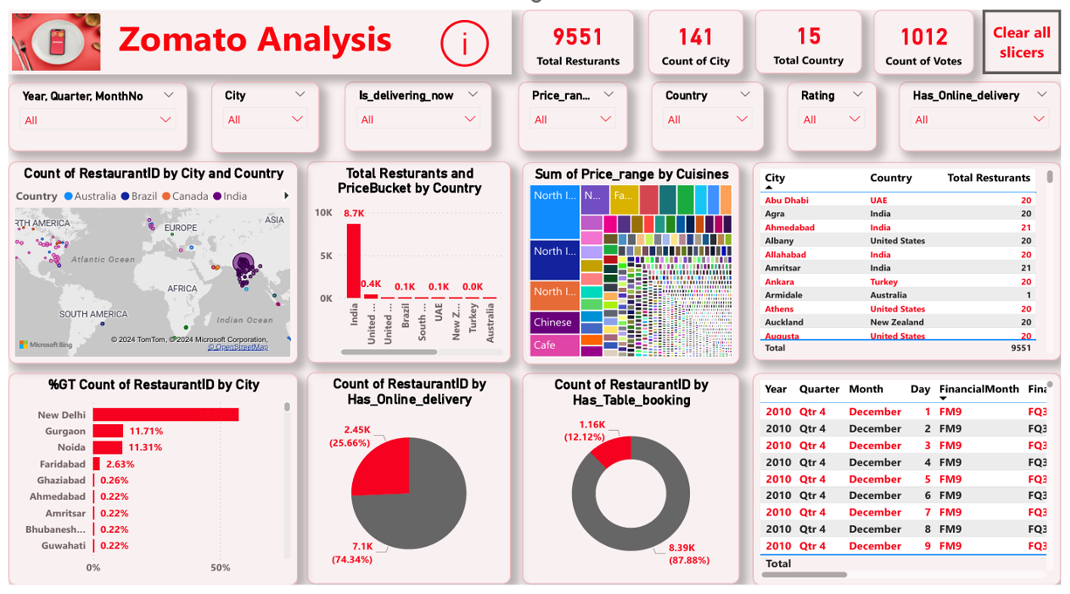

Slide 14
Recommendations
Number of Restaurants by Country:
Expand in High-Growth Countries
Target Local Preferences
Evaluate Competition
Count of Restaurants by Rating:
Improve Customer Experience
Encourage Reviews
Monitor and Respond to Reviews
Number of Restaurants by Opening Year, Month, and Quarter:
Focus on Seasonality Trends
Continuous Innovation
Plan Operational Resources
Restaurant Bucket Analysis Based on Average Price:
Diversify Pricing Strategy
Marketing Strategies Based on Bucket
Adjust Offerings by Region

Slide 15
CONCLUSION
The Zomato Report have 9,551 restaurants over 15 countries and 141 cities. Zomato is largest worldwide business . Zomato restaurants have online orders and table booking . It have percentage count of restaurants by cities and count of restaurants by city and country . Zomato have price buckets by country , cuisines, Average rating and showing a range of consumer preferences.
Global Expansion Opportunities, customer preferences and services, percentage based on ratings and many more.

Slide 16
Thank you

